Slide 1
7 Algorithm design and problem-solving
How to produce algorithms using pseudocode and flowcharts

Slide 2

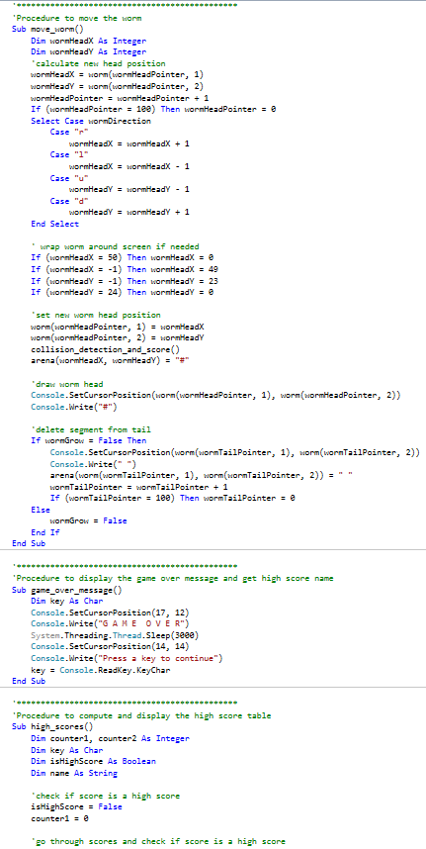
How to produce algorithms using pseudocode and flowcharts
In the exam you need to be able to create, interpret, correct and refine algorithms using:
Pseudocode
Flowcharts

Slide 3
Flowcharts
Start
A flowchart is a method of representing the sequences of steps in an algorithm in the form of a diagram.
Input number1 from the keyboard
Input number2 from the keyboard
Is number1 greater than number2?
YES
NO
Output “The largest number is number1”
Output “The largest number is number2”
Stop

Slide 4
Flowcharts
Start
A flowchart is a method of representing the sequences of steps in an algorithm in the form of a diagram.
Input number1 from the keyboard
Input number2 from the keyboard
Is number1 greater than number2?
YES
NO
Output “The largest number is..." number1
Output “The largest number is..." number2
Stop

Slide 5
Flowcharts
Start
A flowchart is a method of representing the sequences of steps in an algorithm in the form of a diagram.
Input number1 from the keyboard
Input number2 from the keyboard
Is number1 greater than number2?
YES
NO
Output “The largest number is..." number1
Output “The largest number is..." number2
Stop

Slide 6
Flowcharts
Start
A flowchart is a method of representing the sequences of steps in an algorithm in the form of a diagram.
Input number1 from the keyboard
Input number2 from the keyboard
Is number1 greater than number2?
YES
NO
Output “The largest number is..." number1
Output “The largest number is..." number2
Stop

Slide 7
Flowcharts
Start
A flowchart is a method of representing the sequences of steps in an algorithm in the form of a diagram.
Input number1 from the keyboard
Input number2 from the keyboard
Is number1 greater than number2?
YES
NO
Output “The largest number is..." number1
Output “The largest number is..." number2
Stop

Slide 8
Flowcharts
Start
A flowchart is a method of representing the sequences of steps in an algorithm in the form of a diagram.
Input number1 from the keyboard
Input number2 from the keyboard
Is number1 greater than number2?
YES
NO
Output “The largest number is..." number1
Output “The largest number is..." number2
Stop

Slide 9


Pseudocode
Pseudocode is an alternative, text-based way of representing the sequence of steps in an algorithm.
The prefix pseudo means false or not genuine.
Pseudocode can be thought of as a simplified form of programming code.
It allows us to lay down the logic of a problem in an almost-like-real-code way without worrying about the actual rules and syntax of a particular language.

Slide 10
Pseudocode
Start
//Program to output the largest of the two numbers
DECLARE number1 : INTEGER
DECLARE number2 : INTEGER
INPUT number1
INPUT number2
IF number1 > number2
THEN
OUTPUT "The largest number is ", number1
ELSE
OUTPUT "The largest number is ", number2
ENDIF
Input number1 from the keyboard
Input number2 from the keyboard
Is number1 greater than number2?
YES
NO
Output “The largest number is..." number1
Output “The largest number is..." number2
Stop

Slide 11
Pseudocode
Start
//Program to output the largest of the two numbers
DECLARE number1 : INTEGER
DECLARE number2 : INTEGER
INPUT number1
INPUT number2
IF number1 > number2
THEN
OUTPUT "The largest number is ", number1
ELSE
OUTPUT "The largest number is ", number2
ENDIF
Input number1 from the keyboard
Input number2 from the keyboard
Is number1 greater than number2?
YES
NO
Output “The largest number is..." number1
Output “The largest number is..." number2
Stop

Slide 12
Pseudocode
Start
//Program to output the largest of the two numbers
DECLARE number1 : INTEGER
DECLARE number2 : INTEGER
INPUT number1
INPUT number2
IF number1 > number2
THEN
OUTPUT "The largest number is ", number1
ELSE
OUTPUT "The largest number is ", number2
ENDIF
Input number1 from the keyboard
Input number2 from the keyboard
Is number1 greater than number2?
YES
NO
Output “The largest number is..." number1
Output “The largest number is..." number2
Stop

Slide 13
Pseudocode
Start
//Program to output the largest of the two numbers
DECLARE number1 : INTEGER
DECLARE number2 : INTEGER
INPUT number1
INPUT number2
IF number1 > number2
THEN
OUTPUT "The largest number is ", number1
ELSE
OUTPUT "The largest number is ", number2
ENDIF
Input number1 from the keyboard
Input number2 from the keyboard
Is number1 greater than number2?
YES
NO
Output “The largest number is..." number1
Output “The largest number is..." number2
Stop

Slide 14
Pseudocode
Start
//Program to output the largest of the two numbers
DECLARE number1 : INTEGER
DECLARE number2 : INTEGER
INPUT number1
INPUT number2
IF number1 > number2
THEN
OUTPUT "The largest number is ", number1
ELSE
OUTPUT "The largest number is ", number2
ENDIF
Input number1 from the keyboard
Input number2 from the keyboard
Is number1 greater than number2?
YES
NO
Output “The largest number is..." number1
Output “The largest number is..." number2
Stop

Slide 15
Pseudocode
Start
//Program to output the largest of the two numbers
DECLARE number1 : INTEGER
DECLARE number2 : INTEGER
INPUT number1
INPUT number2
IF number1 > number2
THEN
OUTPUT "The largest number is ", number1
ELSE
OUTPUT "The largest number is ", number2
ENDIF
Input number1 from the keyboard
Input number2 from the keyboard
Is number1 greater than number2?
YES
NO
Output “The largest number is..." number1
Output “The largest number is..." number2
Stop

Slide 16
Flowchart symbols
Terminal
Input/output
Process
Subroutine
Decision
Line

Slide 17
Flowchart symbols
Terminal
Input/output
Process
Subroutine
Decision
Line

Slide 18
Flowchart symbols
Terminal
Input/output
Process
Subroutine
Decision
Line

Slide 19
Flowchart symbols
Terminal
Input/output
Process
Subroutine
Decision
Line

Slide 20
Flowchart symbols
Terminal
Input/output
Process
Subroutine
Decision
Line

Slide 21
Flowchart symbols
Terminal
Input/output
Process
Subroutine
Decision
Line

Slide 22
Flowchart symbols
Terminal
Input/output
Process
Subroutine
Decision
Line

Slide 23
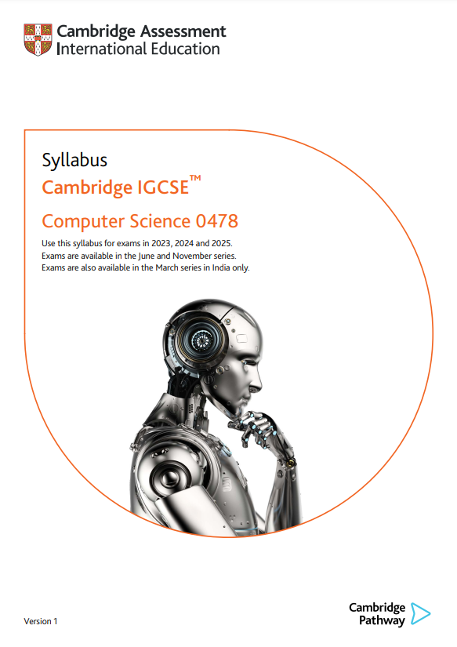
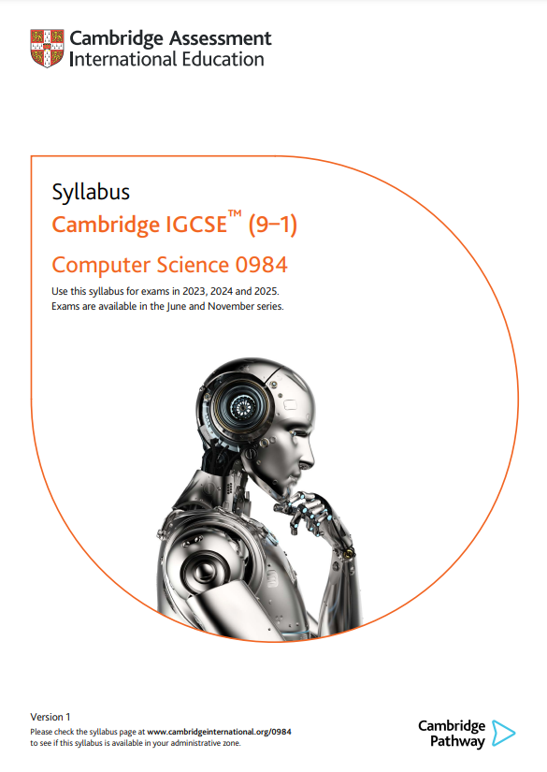
Cambridge IGCSE pseudocode
The pseudocode in these videos follows the exact style which will be used in your exams.
The full set of pseudocode is defined in the syllabus:
Cambridge IGCSE (9-1) Computer Science – 0984
Cambridge IGCSE (A*-G) Computer Science – 0478

Slide 24


